Slide 1
Self-Learning Tutorial

Slide 2
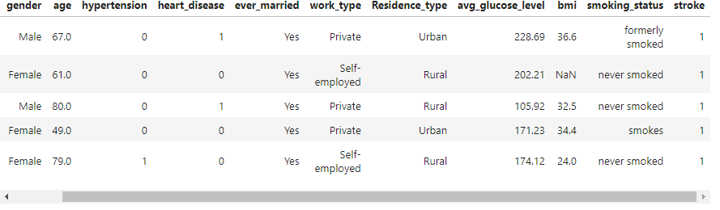
Introduction
The dataset I used for this tutorial contains data that is relevant to how likely a patient is to suffer from a stroke(glucose levels, age, etc).
Dataset here: Stroke Dataset
https://www.kaggle.com/datasets/fedesoriano/stroke-prediction-dataset/code
The goal of the ML model is to predict the likelihood of a patient having a stroke based on the relevant health data.

Slide 3
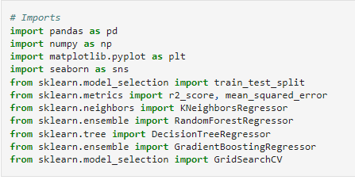
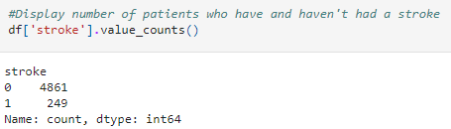
First, let’s import packages we’ll need and take a look at how many patients have had and haven’t had a stroke(1 for stroke and 0 for no stroke).

Slide 4
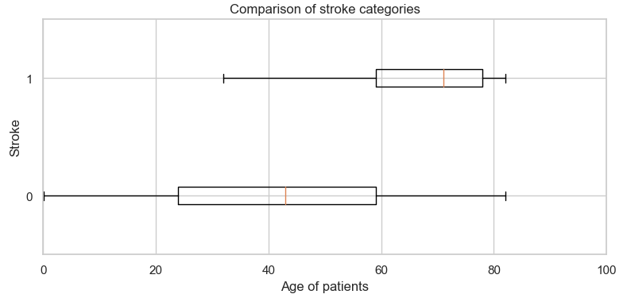
Let’s do a couple of visualizations to understand our data better.
Here’s a boxplot showing the distributions of age between the two stroke groups.
We can see that the median patient that has had a stroke is much older than the median patient who has not.

Slide 5
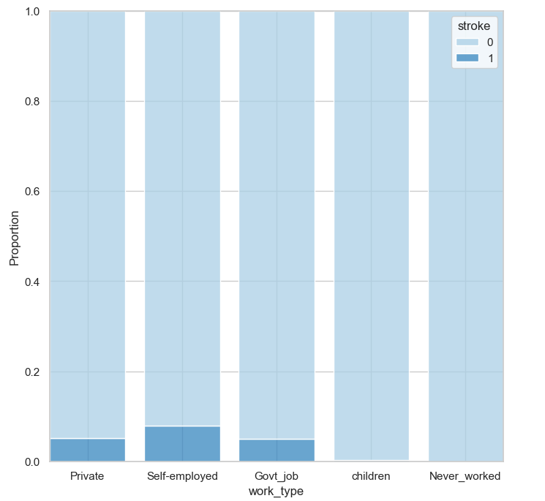
Here’s a proportion histogram looking at proportions of patients who have had a stroke based on their profession.
It looks like patients who are self-employed have the highest proportion of those who have had a stroke, while there are close to 0 children and patients who have never worked who have had a stroke.

Slide 6
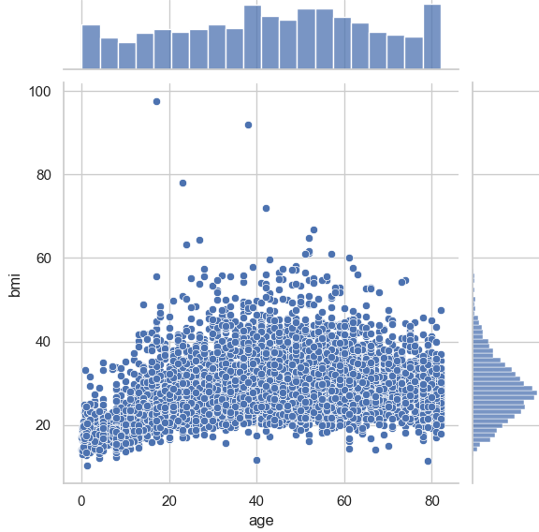

Here’s a scatter plot plotting observations of age against BMI(body mass index).
It looks like there are some outliers for BMI that might be unrealistic. There are also some patients with null values for BMI, so let’s remove those observations so we can have a better model.

Slide 7
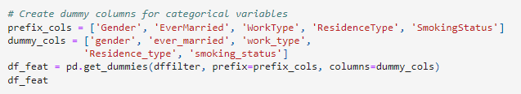
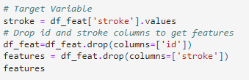
Before we create our model, we have to prepare our data first.
Let’s create dummy variables for our categorical variables and create dataframes for our stroke column and features.

Slide 8
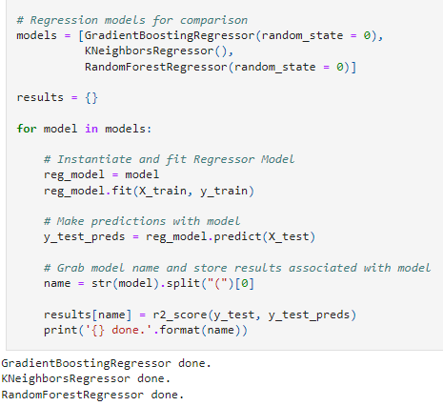
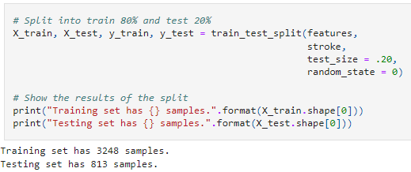
From there we can split our data into train and test sets, and fit them to regression models. I used Random Forest, KNeighbors, and Gradient Boosting regression models.

Slide 9
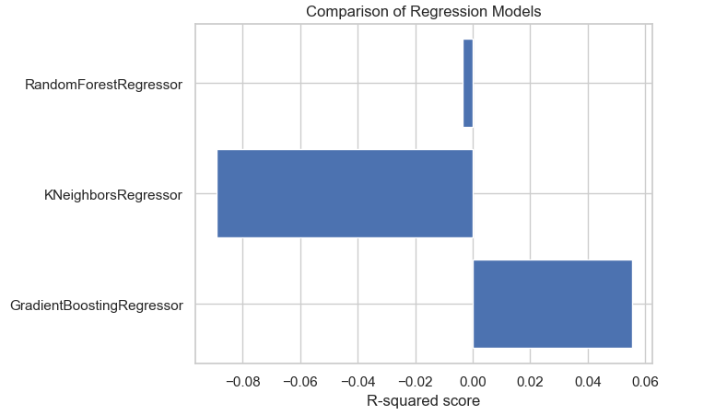
Here’s a comparison of how the regression models did with our data. The only model with a positive r-squared value is the gradient boosting model with a .039, so we’ll use that one going forward.

Slide 10
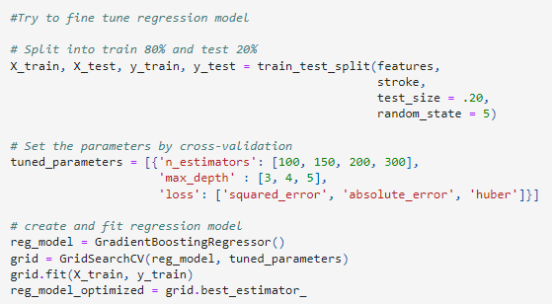

First let’s try to fine tune the model.
We can manually edit parameters to use when fitting the model using GridSearch to get different combinations of parameter values.
Unfortunately, trying to optimize our model actually gave us a worse result.

Slide 11
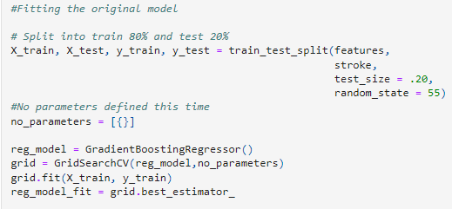
In that case, let’s use our original model.
We’ll still have to fit our data using GridSearch, but we won’t mess with parameters this time.
Fortunately, fitting our original model improved our r-squared value a bit.

Slide 12
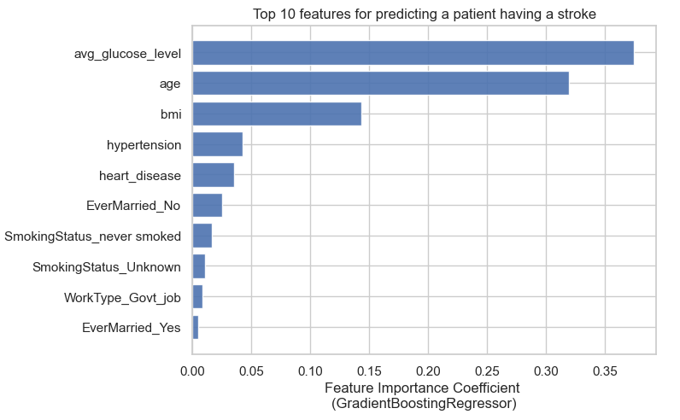
Now we can get the importance of our features. Let’s represent it visually.
It looks like average glucose level and age are the most important features, with BMI being somewhat behind them, and the rest of the features not having a very high value for importance.

Slide 13
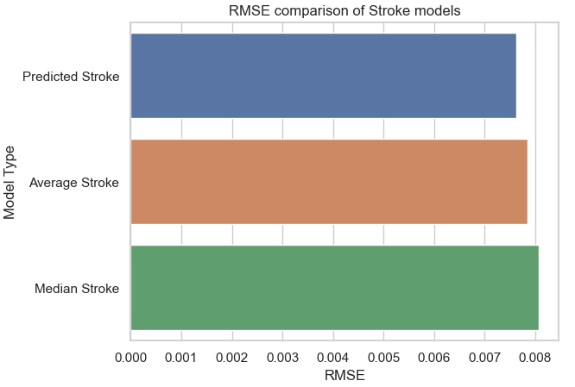
Let’s plot out the RMSE(Root mean squared error) of our model compared with average and median values.
Our model’s RMSE value is slightly lower than the average and median, which means our model is at least decent at predicting whether a patient will have a stroke or not.

Slide 14
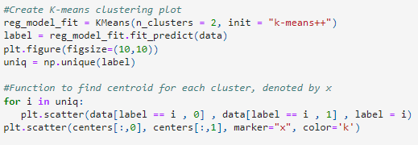

Lastly, lets run a clustering model on our data.
First we have to perform PCA(principal component analysis) on our data to reduce the dimensionality of our fields.
Then we can run a KMeans model to cluster our data.

Slide 15
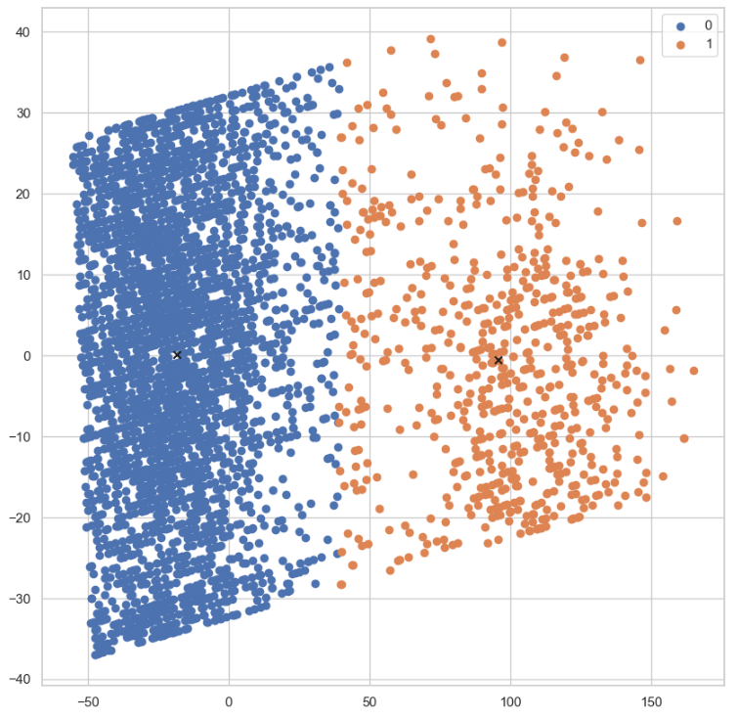
Our KMeans plot has two clusters, a very dense cluster to the left and a less dense one to the right.
I would guess that since there are more patients in our dataset that have not had a stroke, the less dense orange cluster is made up of patients who have had a stroke, which blue being the opposite.

